Slide 1
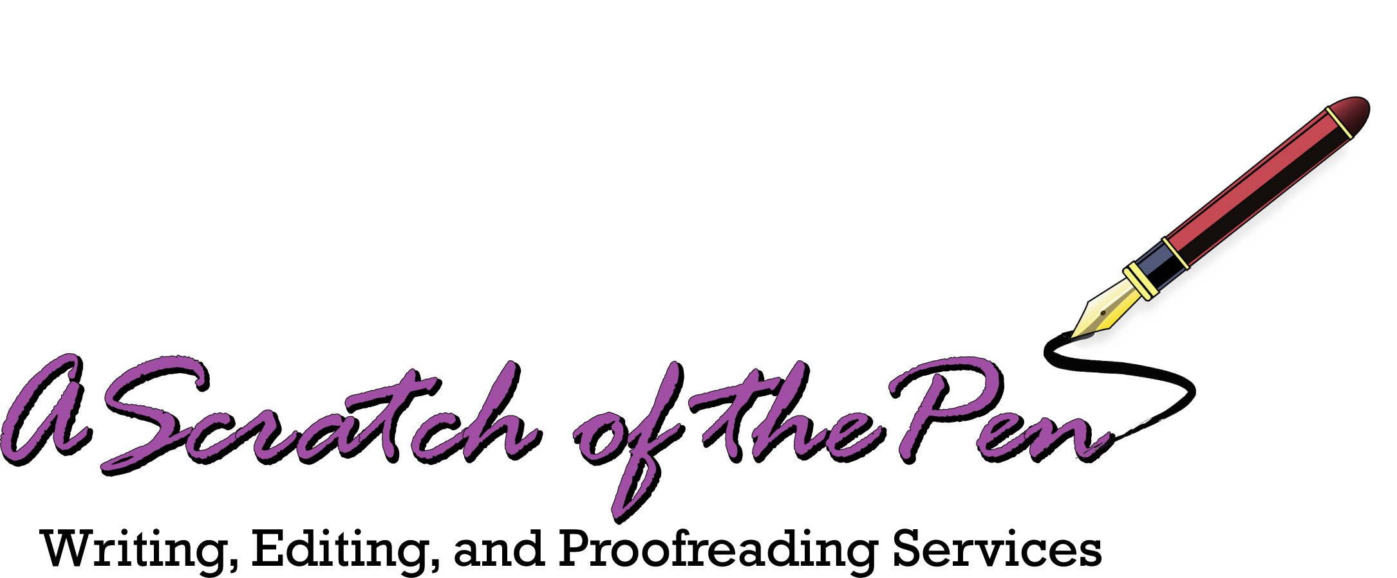


Academic Editing/APA
Resumes
Cover Letters
Resumes for Workers over 50
Proofreading
Ghost Writing
Copywriting
Article Writing
All papers will be submitted to determine a similarity index, but
no AI will be used in the editing and proofing process.
All work will be
conducted by a professional writing instructor and expert in APA formatting who has 15 years’ experience teaching writing at the college and graduate level and editing capstone projects in academic
writing centers.
About
Testimonials
Institutional Contracts Available
for On-Site, Remote, or Virtual Writing Center Services
Owned and Operated by a College Writing Instructor and Writing Center Coordinator
Michael Grohs, Senior Writer and Editor
Contact: ascratchofthepen@gmail.com

